Slide 1

InterviewMate: Fine-Tuning LLMs for Interview Coaching

Slide 2
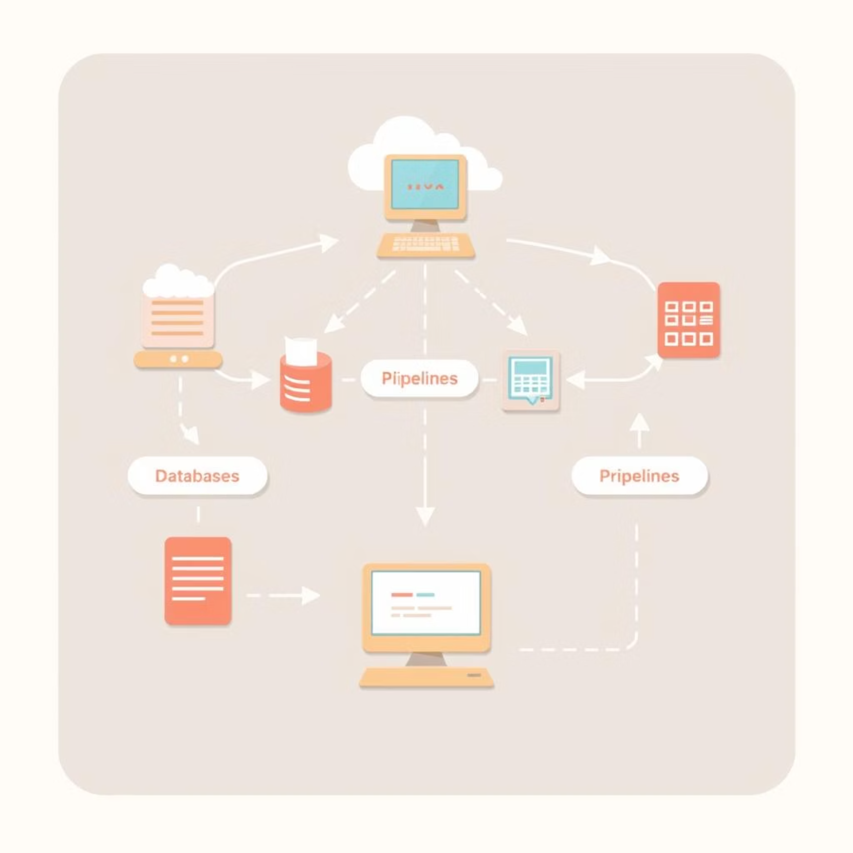
Project Overview & Scope
InterviewMate assists job seekers in data engineering by providing high-quality, structured answers to interview questions.
The system leverages LoRA fine-tuning on a pre-trained Falcon model to significantly reduce memory and training costs while enhancing domain-specific alignment and output quality.

Slide 3




Dataset Preparation & Structure
Custom Dataset
JSON Formatting
150+ curated QA pairs relevant to real-world data engineering interviews.
Data formatted into a JSON structure with "text" fields combining question and response.
Preprocessing
Data Split
Applied truncation and tokenization using the Hugging Face tokenizer.
Dataset split into training, validation, and test subsets using an 80/10/10 ratio.

Slide 4
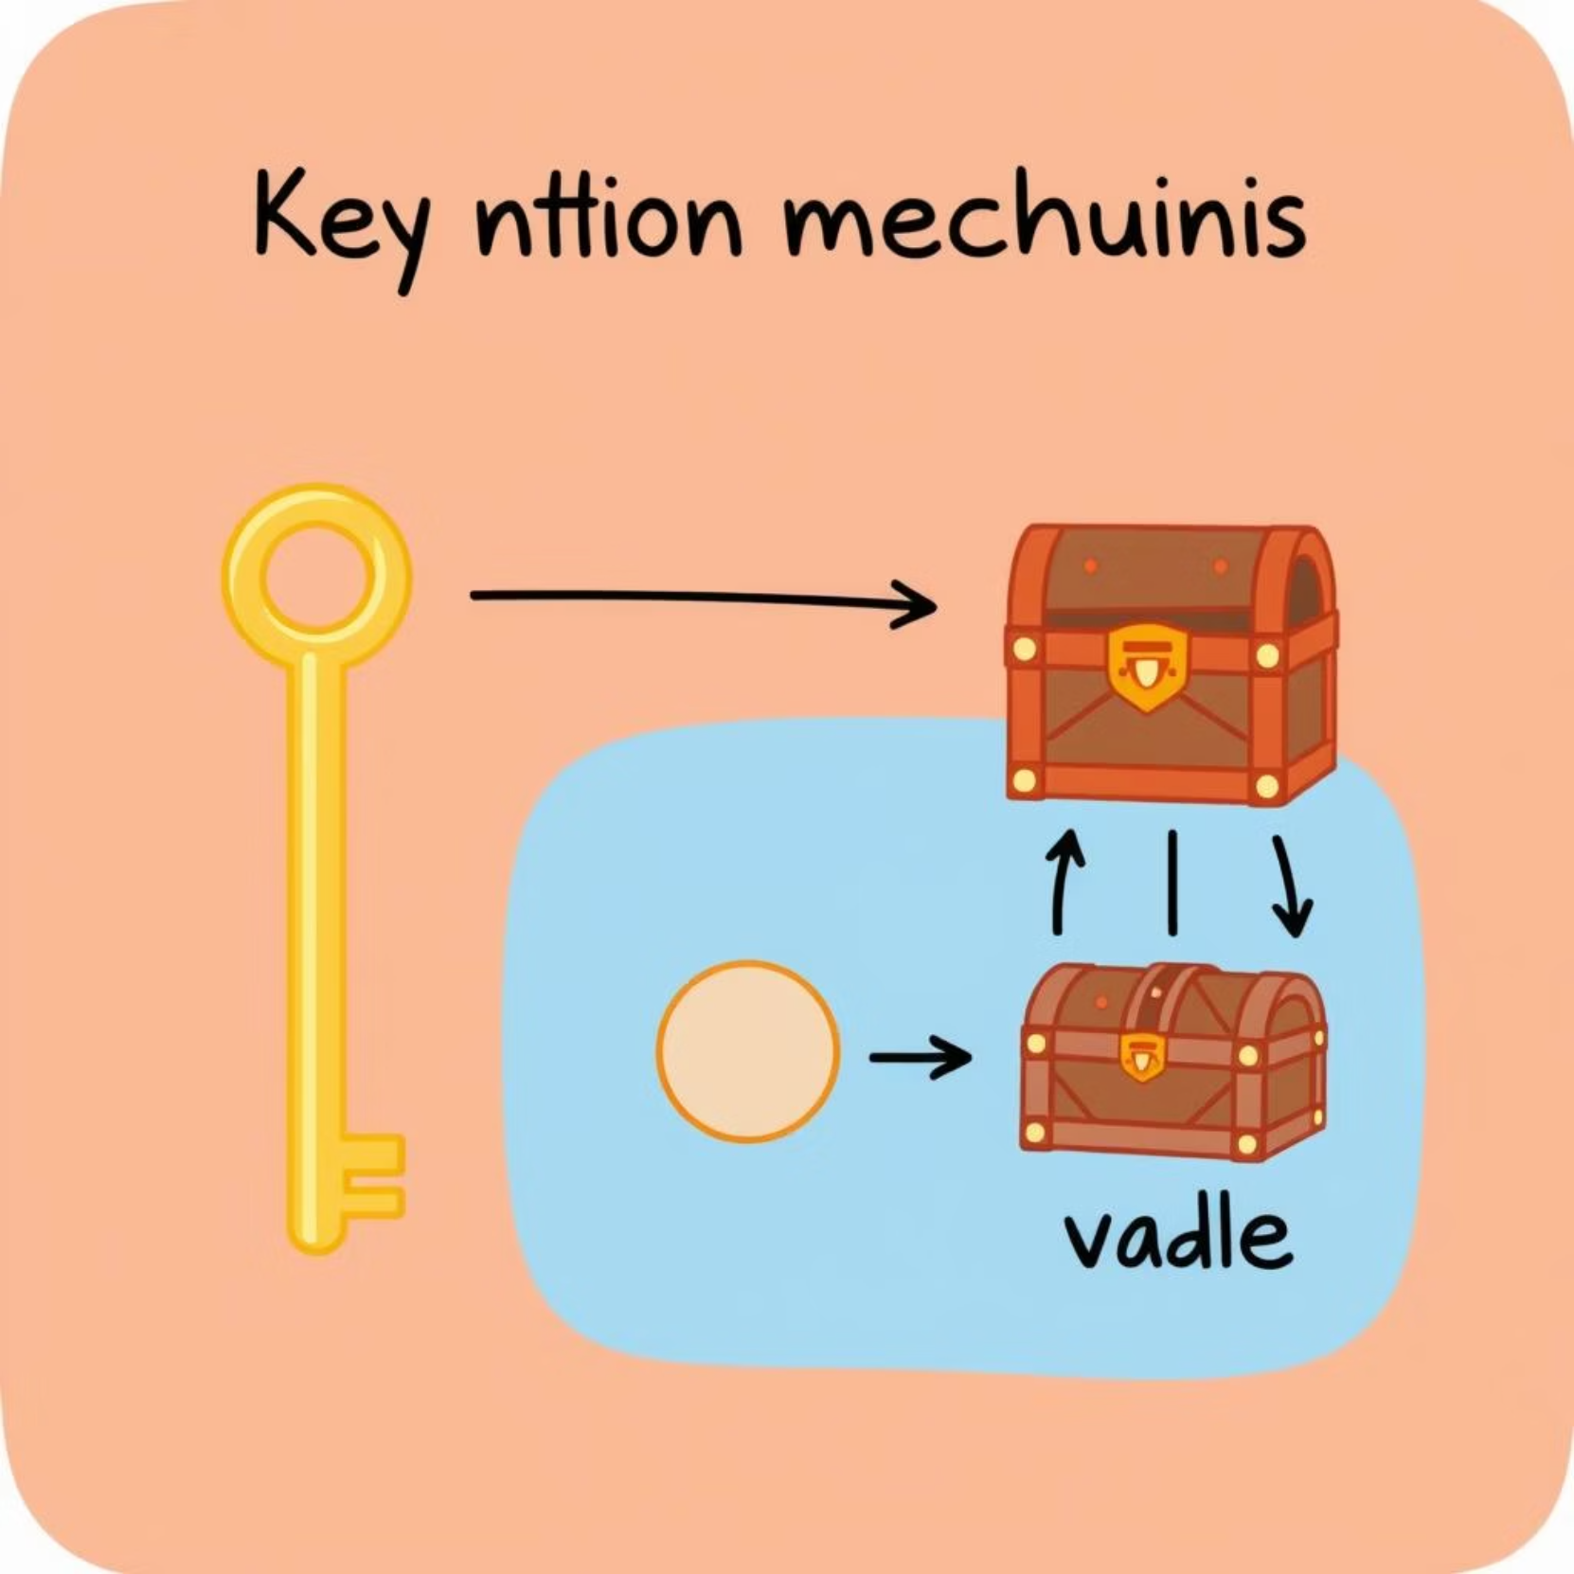
Model Selection & LoRA Setup
Falcon-RW-1B was selected for its optimal balance of performance and resource efficiency, making it suitable for fine-tuning on consumer-grade hardware.
The model was loaded with 4-bit quantization using the transformers and peft libraries, significantly reducing memory footprint.
LoRA was applied with a specific configuration targeting the query_key_value modules to accelerate training and enhance domain alignment without full model retraining.

Slide 5
Fine-Tuning Process with Hugging Face Trainer
The fine-tuning process was managed using Hugging Face’s Trainer API, streamlining the training workflow.
5 Epochs on CPU
Training completed over 5 epochs, leveraging CPU for accessibility.
Batch Size 1
A batch size of 1 with gradient accumulation was used to manage memory effectively.
Enabled Logging
Comprehensive logging provided insights into training progress.
Checkpoint Saving
Checkpoint saving ensured training progress could be resumed or evaluated at various stages.
Model Resizing
Model resizing adapted to custom tokens introduced during preprocessing.
PEFT Adapter Saved
The final PEFT adapter was saved using model.save_pretrained() for efficient inference.

Slide 6
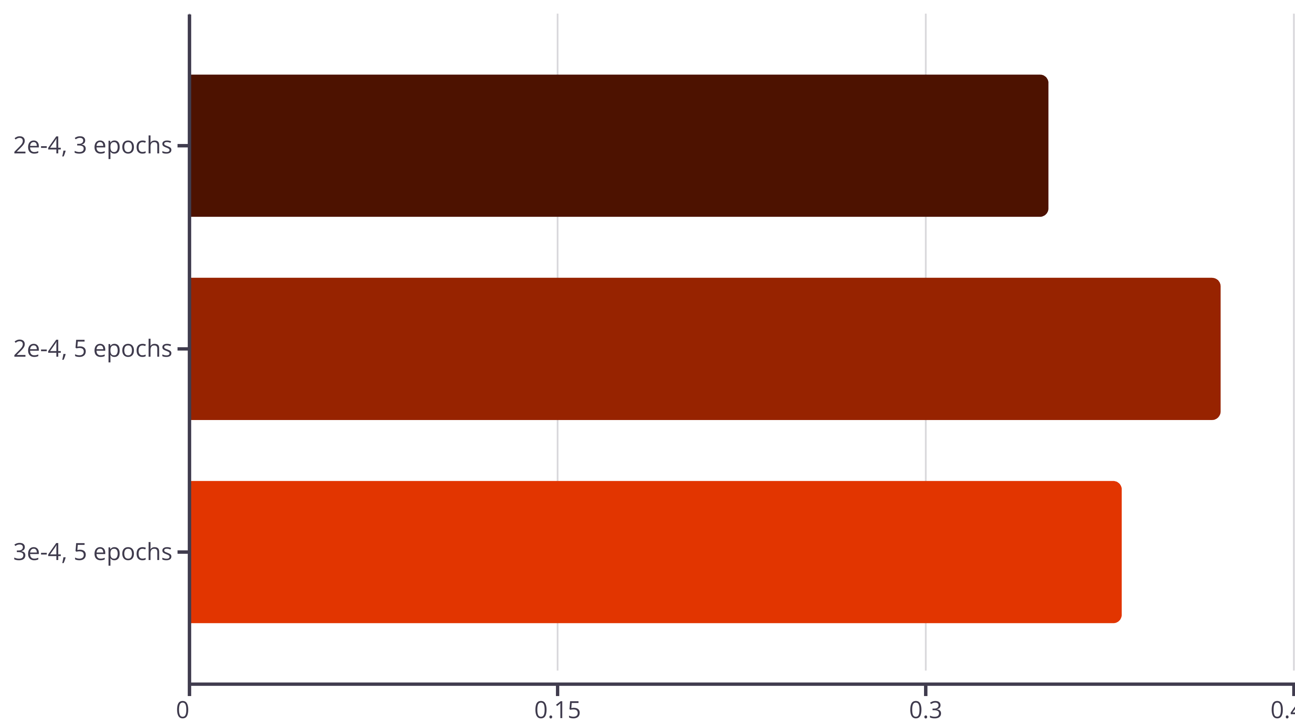
Hyperparameter Tuning & Optimization
Three distinct configurations of learning rate and number of epochs were tested to identify optimal performance:
The second configuration (2e-4 learning rate with 5 epochs) yielded the best results, demonstrating superior performance based on both ROUGE score and qualitative assessments of generated outputs.

Slide 7
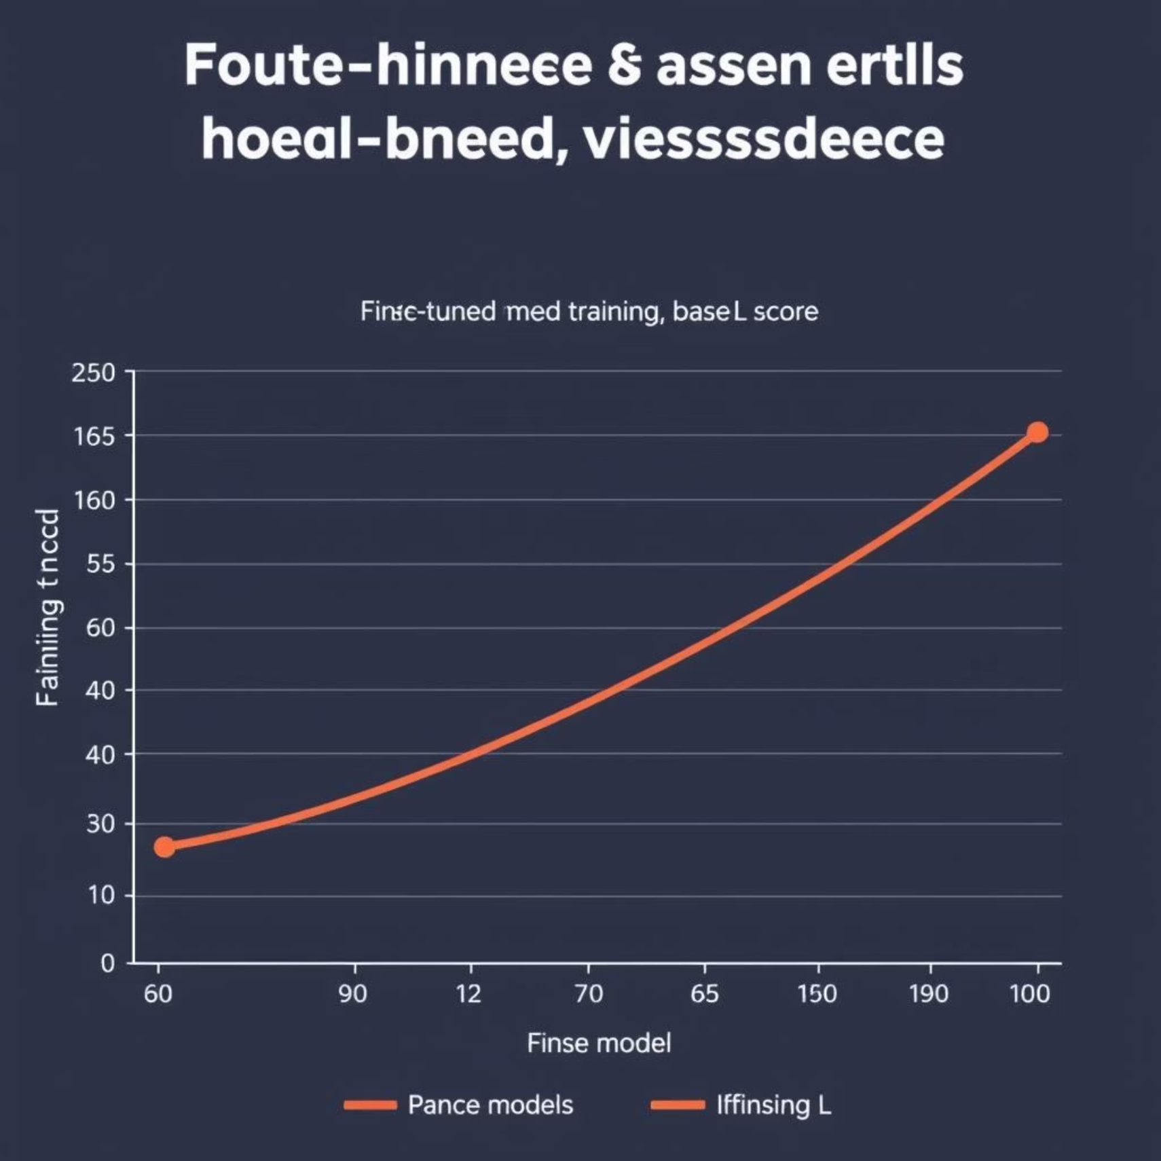
Evaluation & Performance Metrics
Model outputs were evaluated using ROUGE-L, a metric designed to measure the similarity between generated and expected answers.
A sample evaluation set, comprising real test prompts, was utilized to assess the model's performance in a realistic scenario.
Compared to the base Falcon model, the fine-tuned InterviewMate demonstrated a clear and significant improvement in domain-specific coherence and overall answer quality, affirming the effectiveness of the fine-tuning approach.

Slide 8

Error Analysis & Future Improvements
In some instances, the model generated responses that were vague or overly generic, particularly for highly open-ended questions like "What are your strengths?"
Based on this analysis, future iterations will focus on expanding the training dataset with more diverse and abstract prompts to enhance the model's ability to provide varied and in-depth responses for such questions.

Slide 9



Inference Pipeline & Real-World Readiness
Here's a quick demonstration of the InterviewMate inference pipeline:
Load Model
Pass Question
Generate Response
Loading of the fine-tuned model and tokenizer.
Inputting an interview question to the model.
Generation of a response using Hugging Face’s pipeline.
The immediate and relevant outputs demonstrate InterviewMate’s readiness for real-world application, providing instant coaching to job seekers.

Slide 10

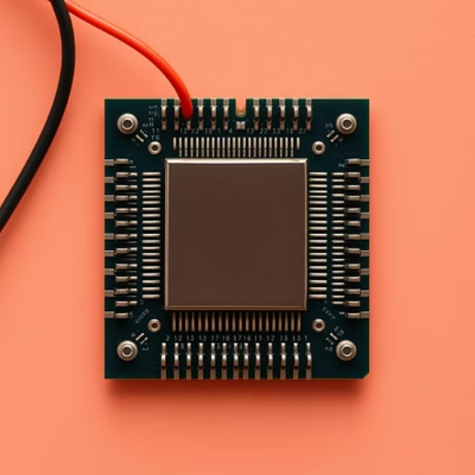
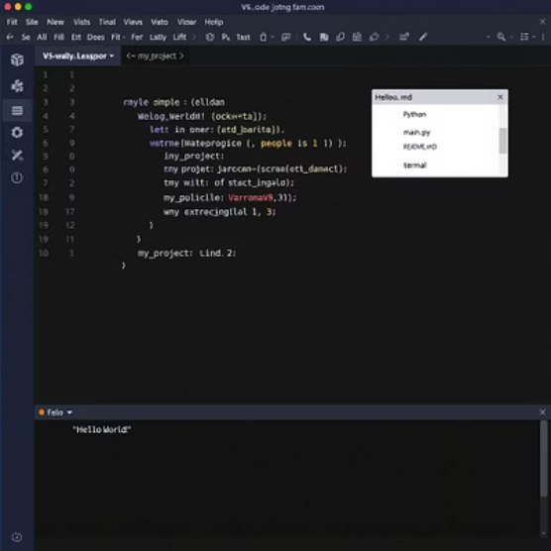
Documentation & Environment Setup
The entire codebase for InterviewMate is thoroughly documented in the README file, providing step-by-step setup instructions for easy deployment.
The project includes the model folder (left_model), requirements.txt, and clear scripts for both training and inference operations.
The environment is optimized for accessibility, allowing the entire project to run efficiently on a CPU with VS Code, requiring minimal memory resources.
Conclusion
In summary, InterviewMate showcases how LoRA fine-tuning can unlock powerful personalization in large language models using modest computational resources. Thank you for your time!

